Slide 1



Planetary_dashboard
View in Power BI
Last data refresh:
9/20/2020 1:00:43 AM India Standard Time
Downloaded at:
9/20/2020 5:07:58 PM India Standard Time

Slide 2
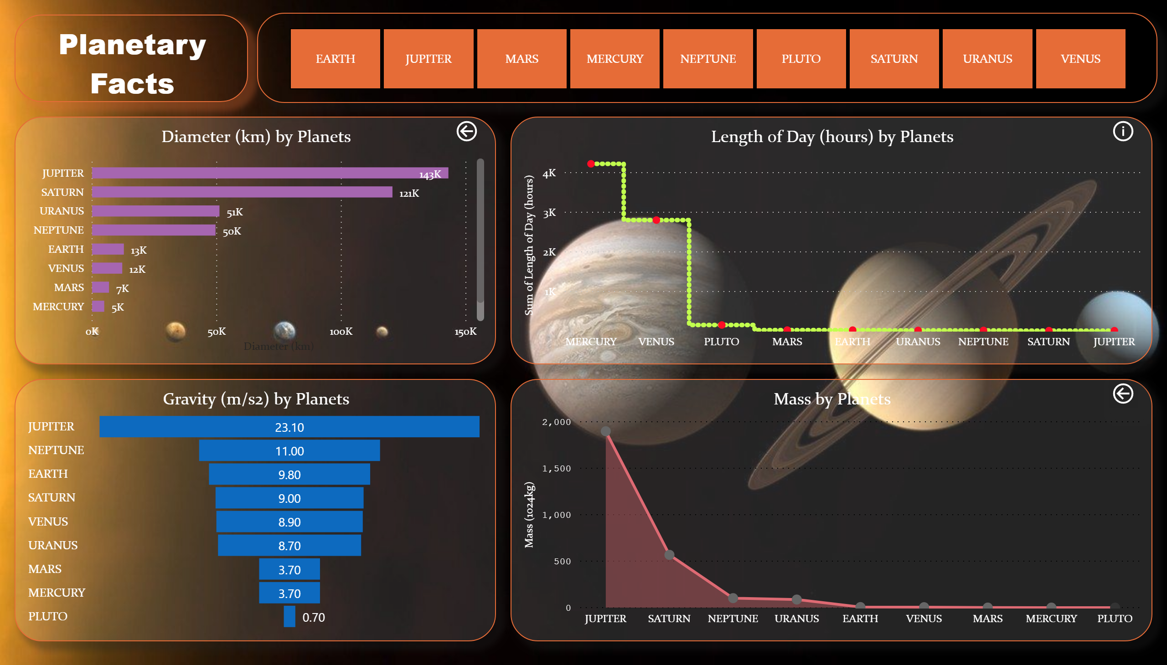

Slide 3
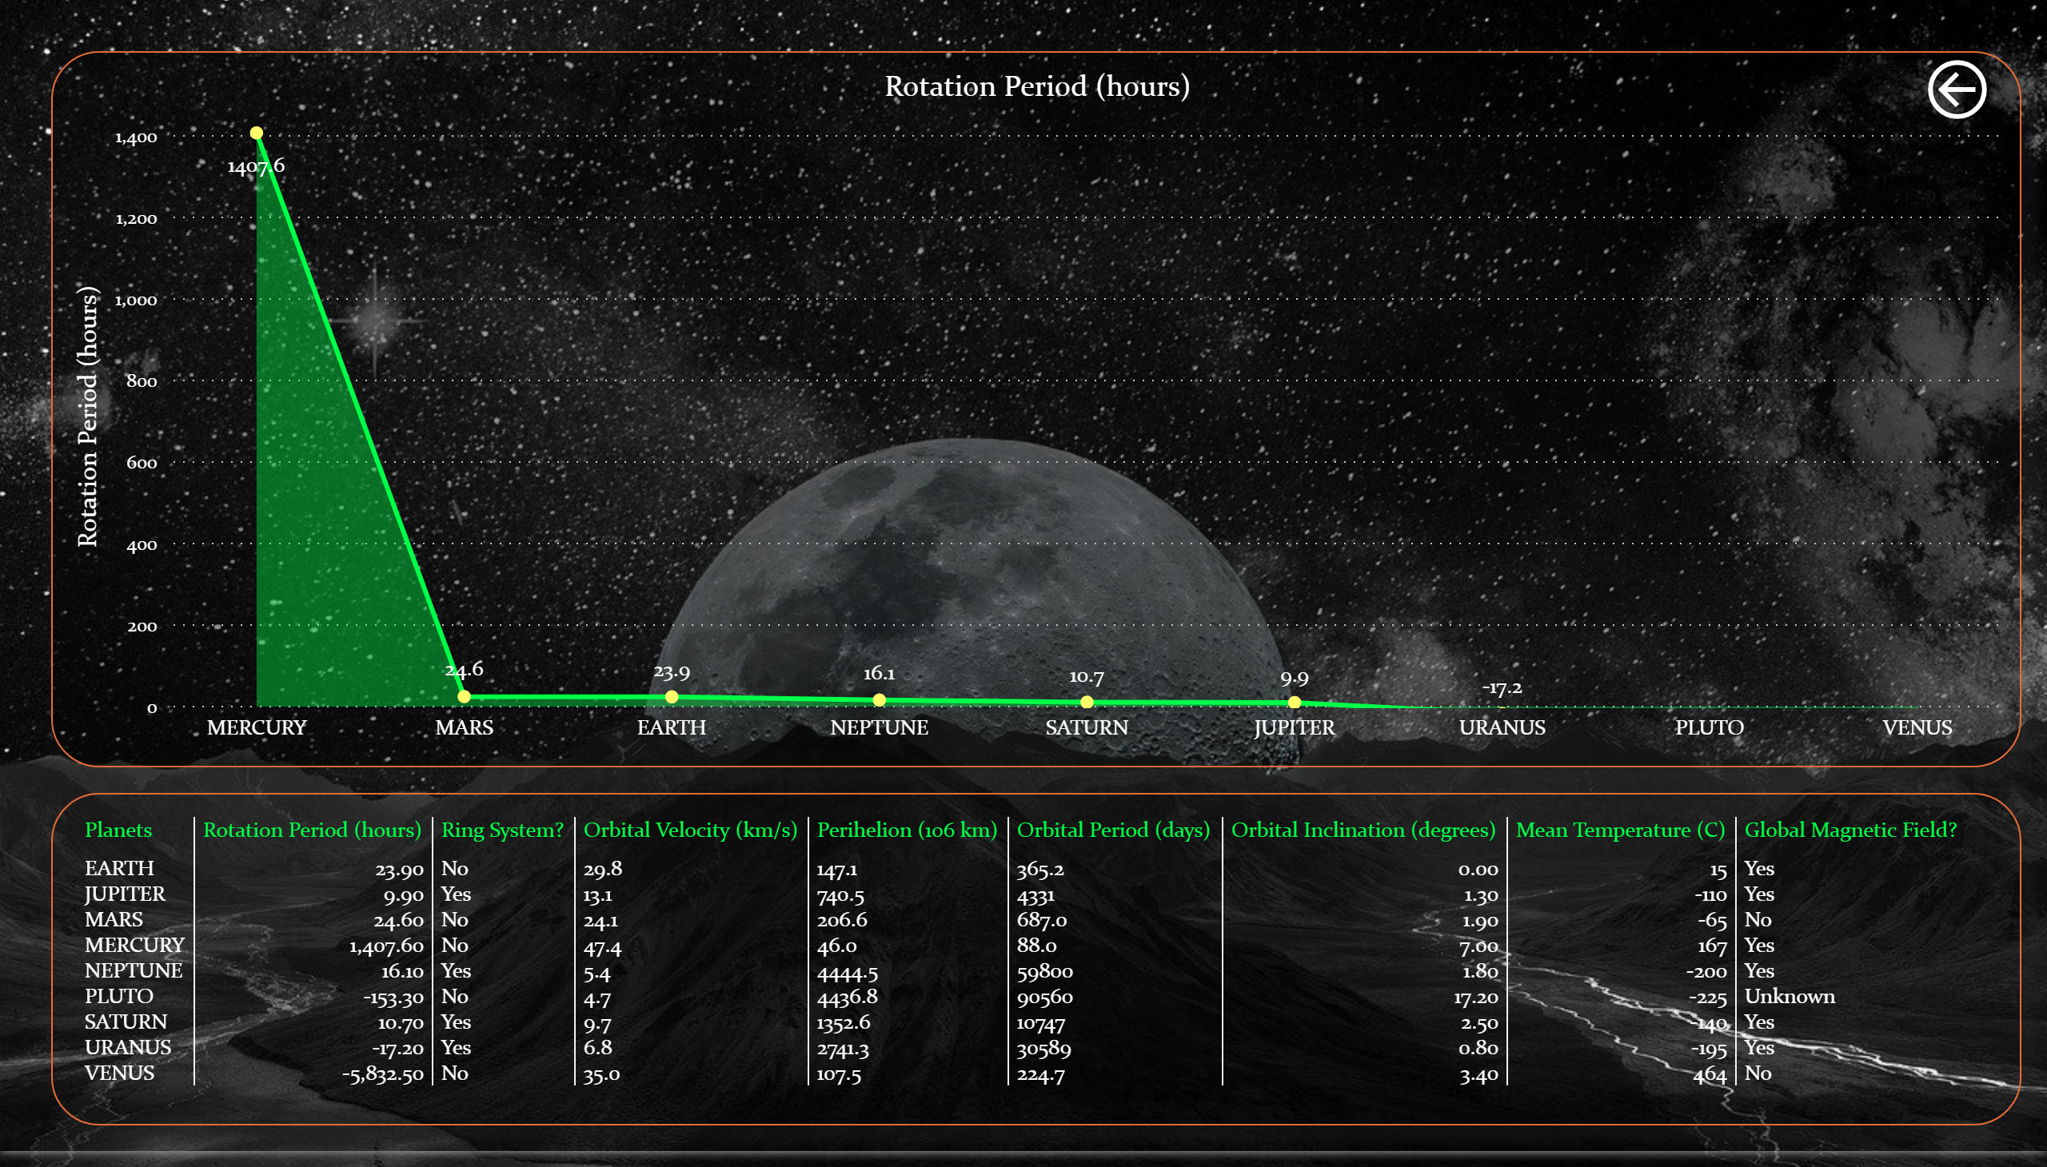

Slide 4
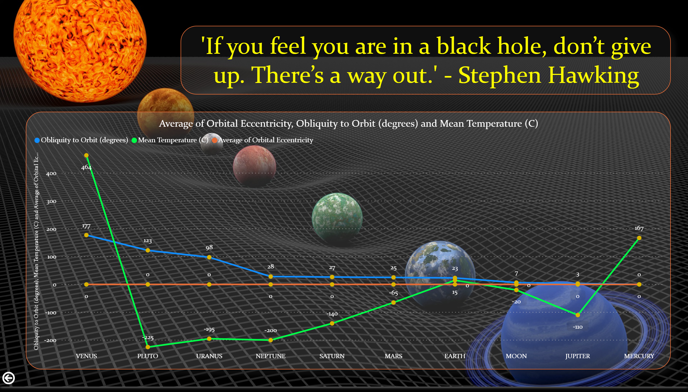

Slide 5
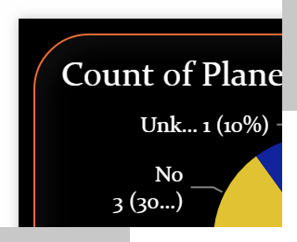

Slide 6
